Slide 1
Computer Vision and Deep Learning
Lecture 13

Slide 2
Final exam
CVDL (coggle.it)

Slide 3
EEML summer school
https://www.eeml.eu/home

Slide 4

Next time: virtual conference Don’t forget to finish your teaser videos by 10th of Jan here

Slide 5
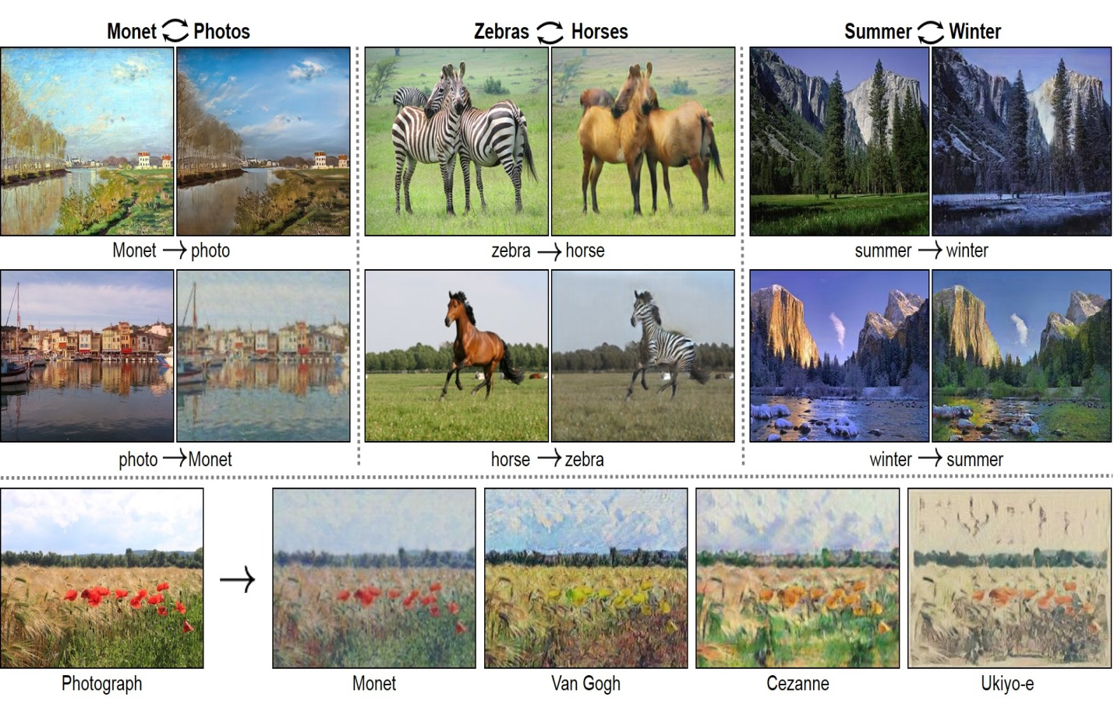
Cycle GAN
https://www.youtube.com/watch?v=D4C1dB9UheQ&ab_channel=TwoMinutePapers

Slide 6
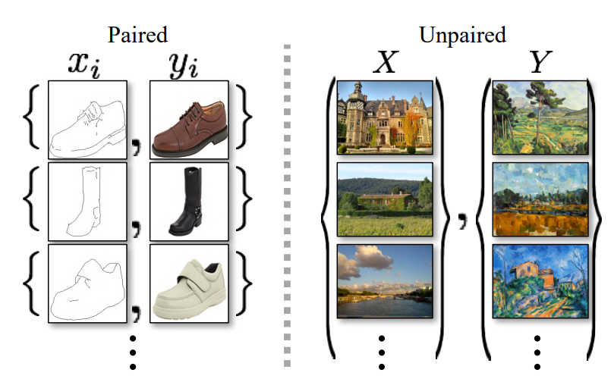
Cycle GAN
Goal: capturing special characteristics of one image collection and figuring out how these characteristics could be translated into the other image collection, all in the absence of any paired training example
supervision is exploited at the level of sets: we are given one set of images in domain X and a different set in domain Y

Slide 7
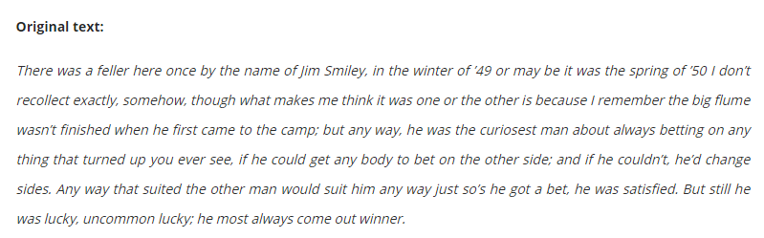

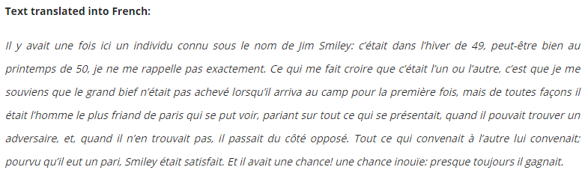
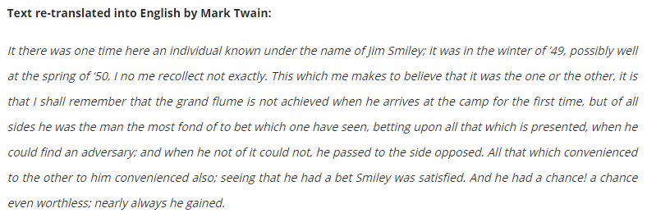
The Jumping Frog: in English, then in French, and then Clawed Back into a Civilized Language Once More by Patient, Unremunerated Toil, Mark Twain

Slide 8
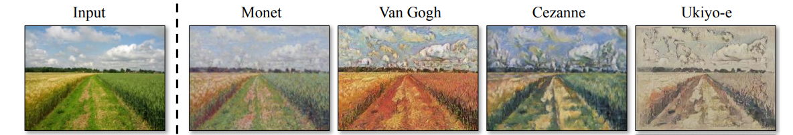
Cycle GAN Unpaired image to image translation
Content - common elements, must be kept in the generated image
Style – unique elements, must be transferred to the generated image

Slide 9
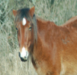

Cycle GAN Unpaired image to image translation
Use two GANs
Cycle consistency: getting the content to be preserved while only changing the styles
GAN X →Y
Real
Fake
Fake
GAN Y →X

Slide 10
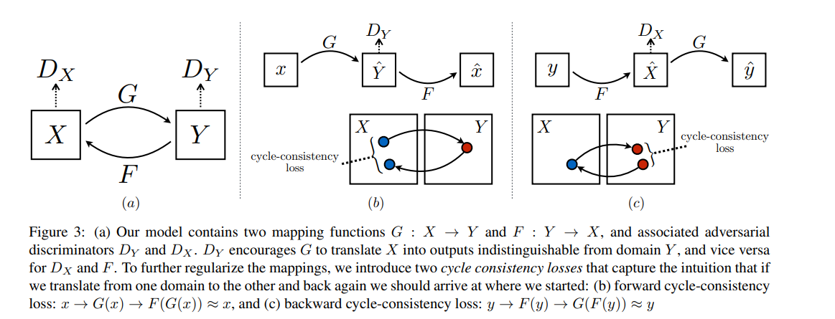
Cycle GAN

Slide 11
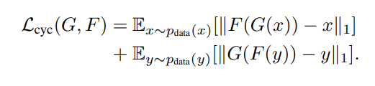
Cycle GAN Cycle consistency loss
GAN X →Y
Real
Fake
Should be roughly the same
Fake
GAN Y →X

Slide 12
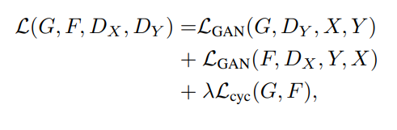
Cycle GAN
Full loss function:

Slide 13
FSGAN
Deep learning–based approach to face swapping and reenactment in images and videos
Subject agnostic: applied to faces of different subjects without requiring subject specific training
https://youtu.be/BsITEVX6hkE?t=7
https://www.youtube.com/watch?v=duo-tHbSdMk

Slide 14
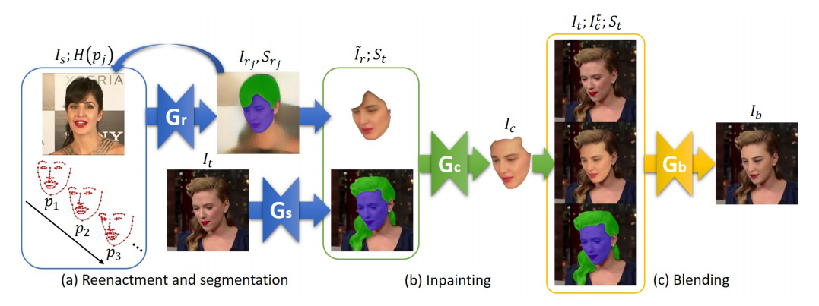
FSGAN
Goal: create a new image based on the target image, such that the face in this image is replaced by the face in the source image, while maintaining the pose and expression
Source image
Fs – face in the source image
Target image
Ft – face in the target image

Slide 15
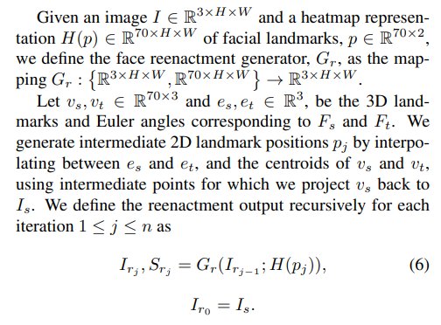
FSGAN
Reenactment generator
Input: heatmaps encoding the face landmarks in the target image
recurrent
Output:
Ir – reenacted image, such that the face in this image (Fr) depicts Fs at the same pose and expression as Ft
Sr – segmentation map of Fs – face and hair

Slide 16
FSGAN
Gs: compute the source image face-hair segmentation
U-Net

Slide 17
FSGAN
Re-enacted image might contain missing parts
Use a face inpainting network

Slide 18
FSGAN
Blend the completed face Fc to the target face, accounting for different skin tones and lighting conditions

Slide 19
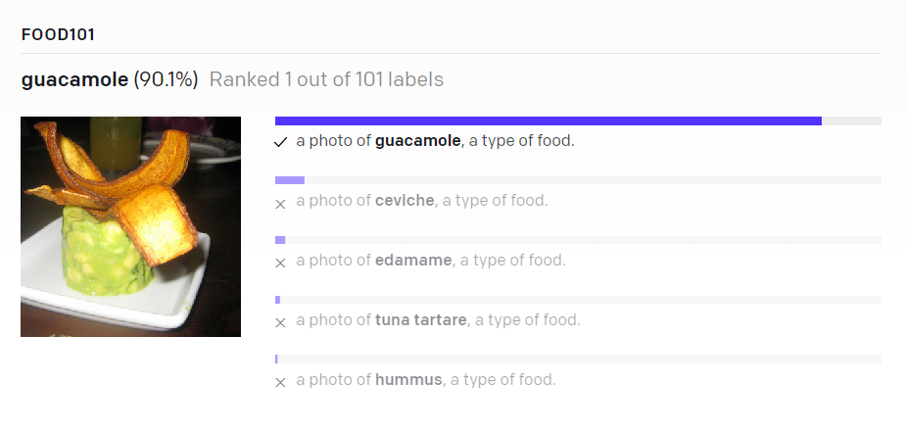
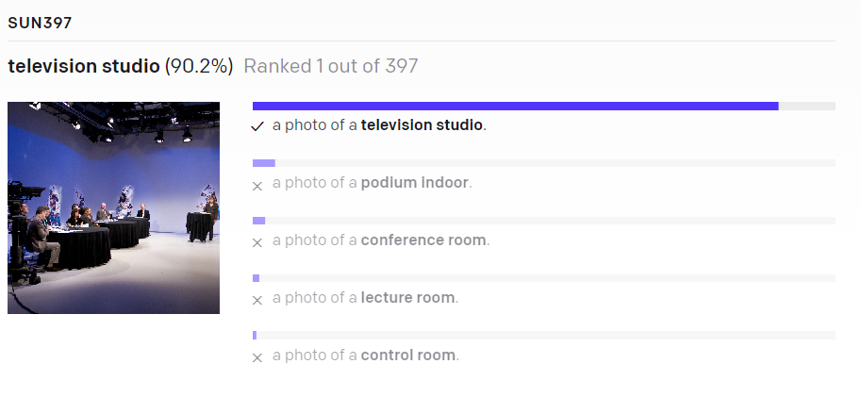
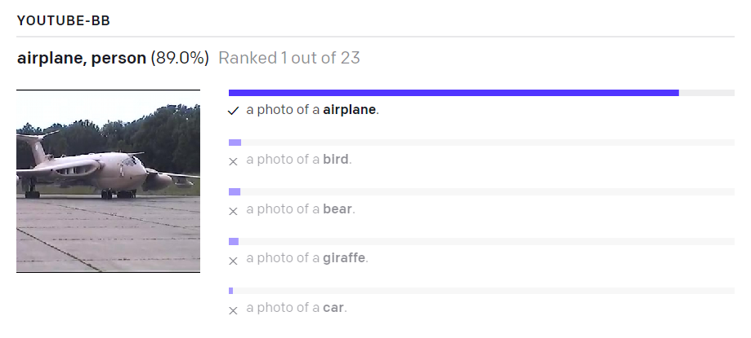
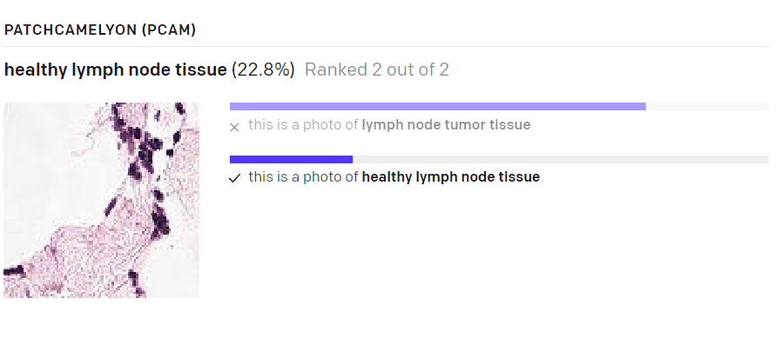
CLIP

Slide 20
Learning Transferable Visual Models From Natural Language Supervision
CLIP
https://arxiv.org/pdf/2103.00020.pdf

Slide 21
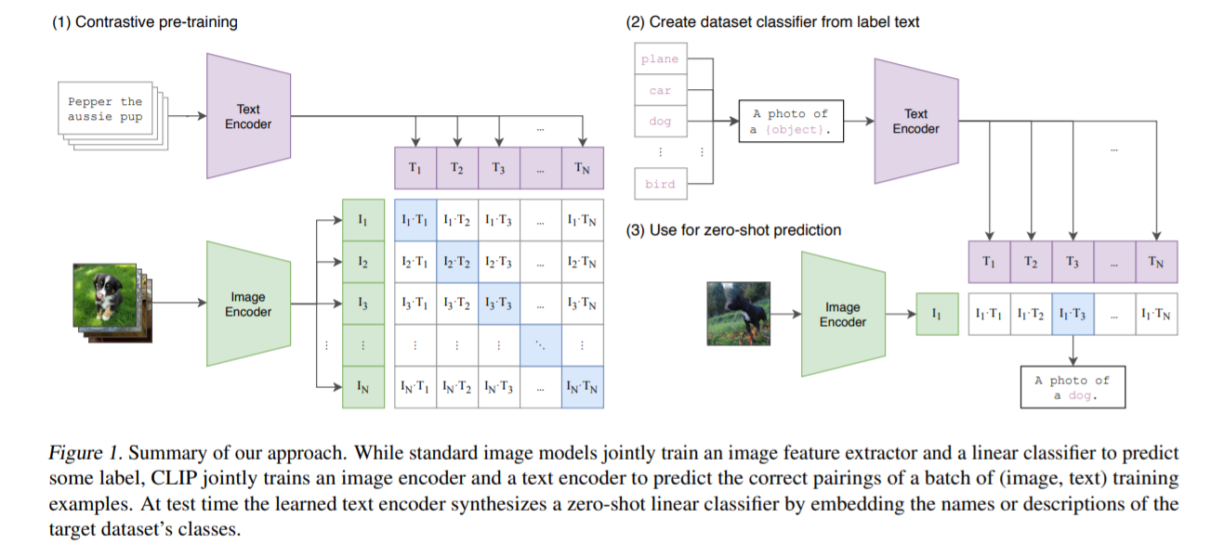
CLIP
https://www.youtube.com/watch?v=u0HG77RNhPE

Slide 22
Zero-Shot Text-to-Image Generation
DALL-E
https://arxiv.org/pdf/2102.12092.pdf
https://openai.com/blog/dall-e/

Slide 23
Dall-E
https://www.youtube.com/watch?v=C7D5EzkhT6A

Slide 24
Deep fake detection
https://www.youtube.com/watch?v=poSd2CyDpyA

